Slide 1
Python For Beginners
Srdjan Todorović
Ivan Dimitrov
Notes:
Zasto smo odabrali ovu temu?
Nasi klijenti (startupi) dosta traze Python
Procentualno najvise backend projekata u Symphony-ju je napisano u Pythonu
Kolege iz naseg okruzenja pokazuju interesovanje za Python

Slide 2
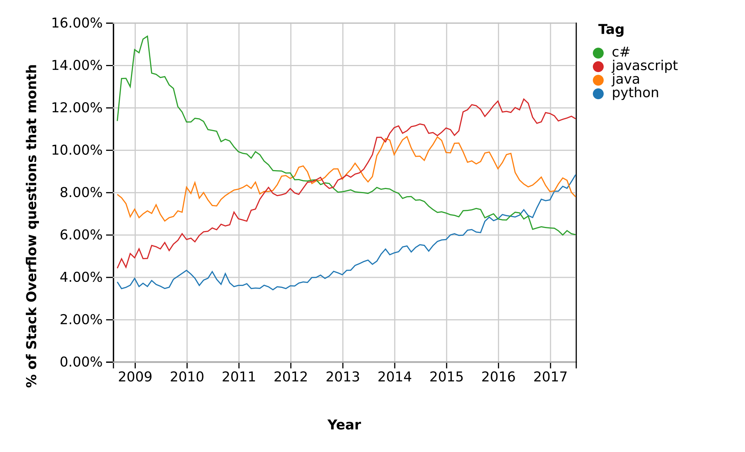
Python popularity - Stack Overflow
Stackoverflow Trends statistics taken on Oct 2017
Notes:
Ovaj graf pokazuje trend kolicine pitanja po tehnologiji na stack overflow sajtu.

Slide 3
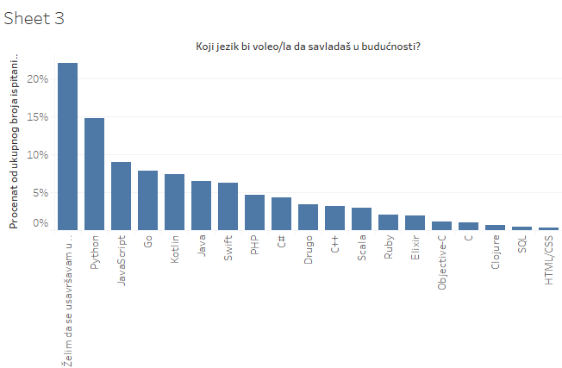
Python popularity - in Serbia
Yearly developer survey in Serbia for 2017.

Slide 4
What makes Python so popular?
Elegant, clean syntax
Designed to be highly readable
Easy to learn
Gradual learning curve
Number one choice for non-programmers
Rapid development
Good set of standard libraries (batteries included)
An abundance of additional libraries
Lots of libraries
~120K
Highly extendable
Embed libraries written in another language
Run the code everywhere
Cross platform
Open-source
Notes:
Dosta ne programera je naucilo python i koristi ga u svom dnevnom poslu da bi ga unapredili - pravljenje manjih alata koji ubrzavaju njihovo poslovanje i boostuju njihov primarni biznis

Slide 5
Python at it’s best
Main areas in which python changed the game:
Science Research (previously mostly used Matlab)
Data Science
Web Scraping
Startups
Simplicity
Lots of libraries and good community
Great libraries
Rapid development

Slide 6
Python main characteristics
Interpreted language - no compile time
Compiled to bytecode
Both dynamically and strongly typed
Object-Oriented
Even classes are objects
Unlike some other OO languages, (e.g. C#, Java) you don’t have to write a single class if you don’t want to
Supports multiple inheritance
Doesn’t support abstraction
Doesn’t support encapsulation
Supports multithreading, only one thread at a time (GIL)
Can’t make use of multiple cores or multiple CPUs
Supports multiprocessing
Can make use of multiple cores or multiple CPUs

Slide 7




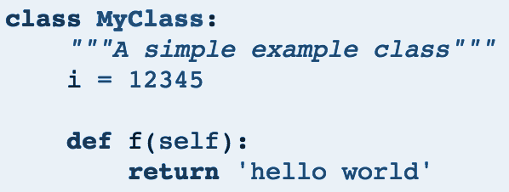
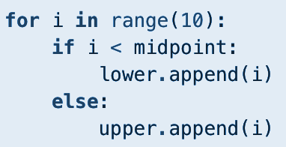


Quick tour of Python syntax
End of line terminates the statement
Semicolon can optionally terminate the statement
Indentation instead of curly braces
# marks the comment
Notes:
Readability counts
Smanjiti nepotrebni unos

Slide 8
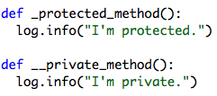
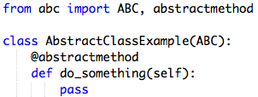

Python and OOP
Doesn’t support all OOP concepts:
Encapsulation by convention
Abstraction through additional module
Interfaces by duck typing
Notes:
Za podrsku principima OOPa se vidi razlike u pythonovoj filizofiji. I kod jezika gde postoji “prava” enkapsulacija, programeru je moguce doci do skrivenih atributa preko refleksije. Python smatra da treba imati stav “We are all grown-ups here” i da ne treba skrivati stvari od korisnika koji ce koiristi te klase. Python vise naginje ka tome da se konvencijama programeru da do znanja da je metoda ili atribut privatan ili javan. Npr _variablename za protected i __variablename za privatne atribute. Razumno da ljudima koji su dosli iz drugika bude cudno sto su ovde neka ogranicenja mnogo labavo uvedena.
Python's "_" doesn't actually stop you from accessing the attribute from outside, it just discourages you.
If you want to check if object is Duck, check for quack()
Pythonic programming style that determines an object's type by inspection of its method or attribute signature rather than by explicit relationship to some type object ("If it looks like a duck and quacks like a duck, it must be a duck.") By emphasizing interfaces rather than specific types, well-designed code improves its flexibility by allowing polymorphic substitution. Duck-typing avoids tests using type() or isinstance(). Instead, it typically employs the EAFP (Easier to Ask Forgiveness than Permission) style of programming.
try: _ = (e for e in my_object) except TypeError: print my_object, 'is not iterable'

Slide 9
Some popular opinions against Python
It is not enterprise-grade
It is just a more advanced language for shell scripts
Lack of static typing
Python is sooooo SLOW!!! And I hate GIL so much, argh
Oh, is it really???
But Python is not *really* multi threaded
Use multiprocessing instead, uses more memory
Notes:
Tesko je opisati sta tacno znaci enteprise-grade. Ali je generalni koncenzus da su to obicno robusne aplikacije koje je lako odrzavati i cesto se finansijske aplikacije vezuju za ovaj termin. Cesto kontra argument ovde je da “enterprise-grade” aplikacije cesto pruzaju osecaj lazne sigurnosti zbog feature-a kao sto su static typing i compile time i da se time programer demotivise da napise dobre i ceste testove. Takodje ako nije enterprise grade jezik zbog cega ga dosta kompanija koje se bave finansijskim poslovima koiriste? PayPal koristi python za svoje alate koji se koriste za razmenu kljuceva sa sigurnost transakcija. Jos neke od velikih “enterprise kompanija koje koriste python YouTube, Instagram, Dropbox)
Its just a more advanced language for shell scripts - Za ovu stavku je delimicno python kriv jer se cesto koristi kao zamena za BASH ili neki drugi skript jezik.
Brzina - Sta uopste znaci brzina jezika? Jezik nije ni brz ni spor. Jezik je jezik i od programera zavisi kojom brzinom ce programirati. Ono o cemu mozemo diskutovati je brzina izvrsavanja odredjenog koda u odredjenom okruzenju. U slucaju Pythona, zahvaljujuci njegovoj fleksibilnosti, moguce je kompajlirati Python kod (Pypy, Cython), cime se znacajno moze ubrzati njegovo izvrsavanje. Da li je jeftinije uloziti vreme u optimizaciju koda ili uzeti dodatni hardver i skalirati aplikaciju
GIL, Global Interpeter Lock, po defaultu onemogucava da se vise tredova izvrsava u isto vreme. Ovo je svesna odluka doneta pri dizajniranju jezika, jer su autori smatrali (sa pravom) da se najtezi bagovi generisu upravo koriscenjem multi threadinga i da u vecini slucajeva cak i usporava izvrsavanje (registri procesora se pune i prazne cesce, semafori). S jedne strane zastitili su korisnike od samih sebe, s druge strane ostavljena je mogucnost da se GIL iskljuci cime se multithreading omogucava. To je prilicno komplikovano i diskutabilno korisno. Pre treba konvertovati logiku i ukljuciti koriscenje mulitprocesing modula koji koristi paralelno izvrsavanje
Python has a GIL as opposed to fine-grained locking for several reasons:
It is faster in the single-threaded case.
It is faster in the multi-threaded case for i/o bound programs.
It is faster in the multi-threaded case for cpu-bound programs that do their compute-intensive work in C libraries.
It makes C extensions easier to write: there will be no switch of Python threads except where you allow it to happen (i.e. between the Py_BEGIN_ALLOW_THREADS and Py_END_ALLOW_THREADS macros).
It makes wrapping C libraries easier. You don't have to worry about thread-safety. If the library is not thread-safe, you simply keep the GIL locked while you call it.

Slide 10
The Zen of Python
Beautiful is better than ugly. Explicit is better than implicit. Simple is better than complex. Complex is better than complicated. Flat is better than nested. Sparse is better than dense. Readability counts.
...

Slide 11
HANDS ON TIME

